Slide 1
Round 2 Phase 2
PROOF OF CONCEPT
(More on our chosen business problem)

Slide 2

Detailed use case for POC
Shopping Centers and other big retail chains have a very big market in the world. The solution proposed will reduce a major part of manual labor with ease. The real time objects will move on a conveyer belt as and when the customer places them on it. The barcodes on the items will be scanned by the barcode scanner inside an enclosed region and the total price is displayed on the LCD screen. When all the items have been scanned, the customer can make the payment and has the option to print a physical bill if required.
After paying the necessary amount either through cash/card/online payment methods, the customer will undergo an anti-theft scan. The customer can then collect his purchase and proceed out.

Slide 3

Solution Design and Architecture
Data from barcode scanner installed on the conveyer belt will be relayed to the raspberry pi using the Wi-Fi module.
Multi-threading technique will be implemented for efficient handling of process queuing.
SQLite3(for local storage) and Google Firebase(for cloud storage) can act as a storage platform for the current bill. The item and the respective price will be shown on the LCD Screen for the customer to check.
When all the items have been scanned, the total amount pops up and the final bill is shown as well as sent to the customers mobile through the already collected details.
The customer will have the option to pay either by cash/card or through UPI payment options through a link sent with the final bill. He/she can also print the bill if required.
One the payment is done, after undergoing an anti-theft scan, he/she can collect the items at the other end of the belt.

Slide 4
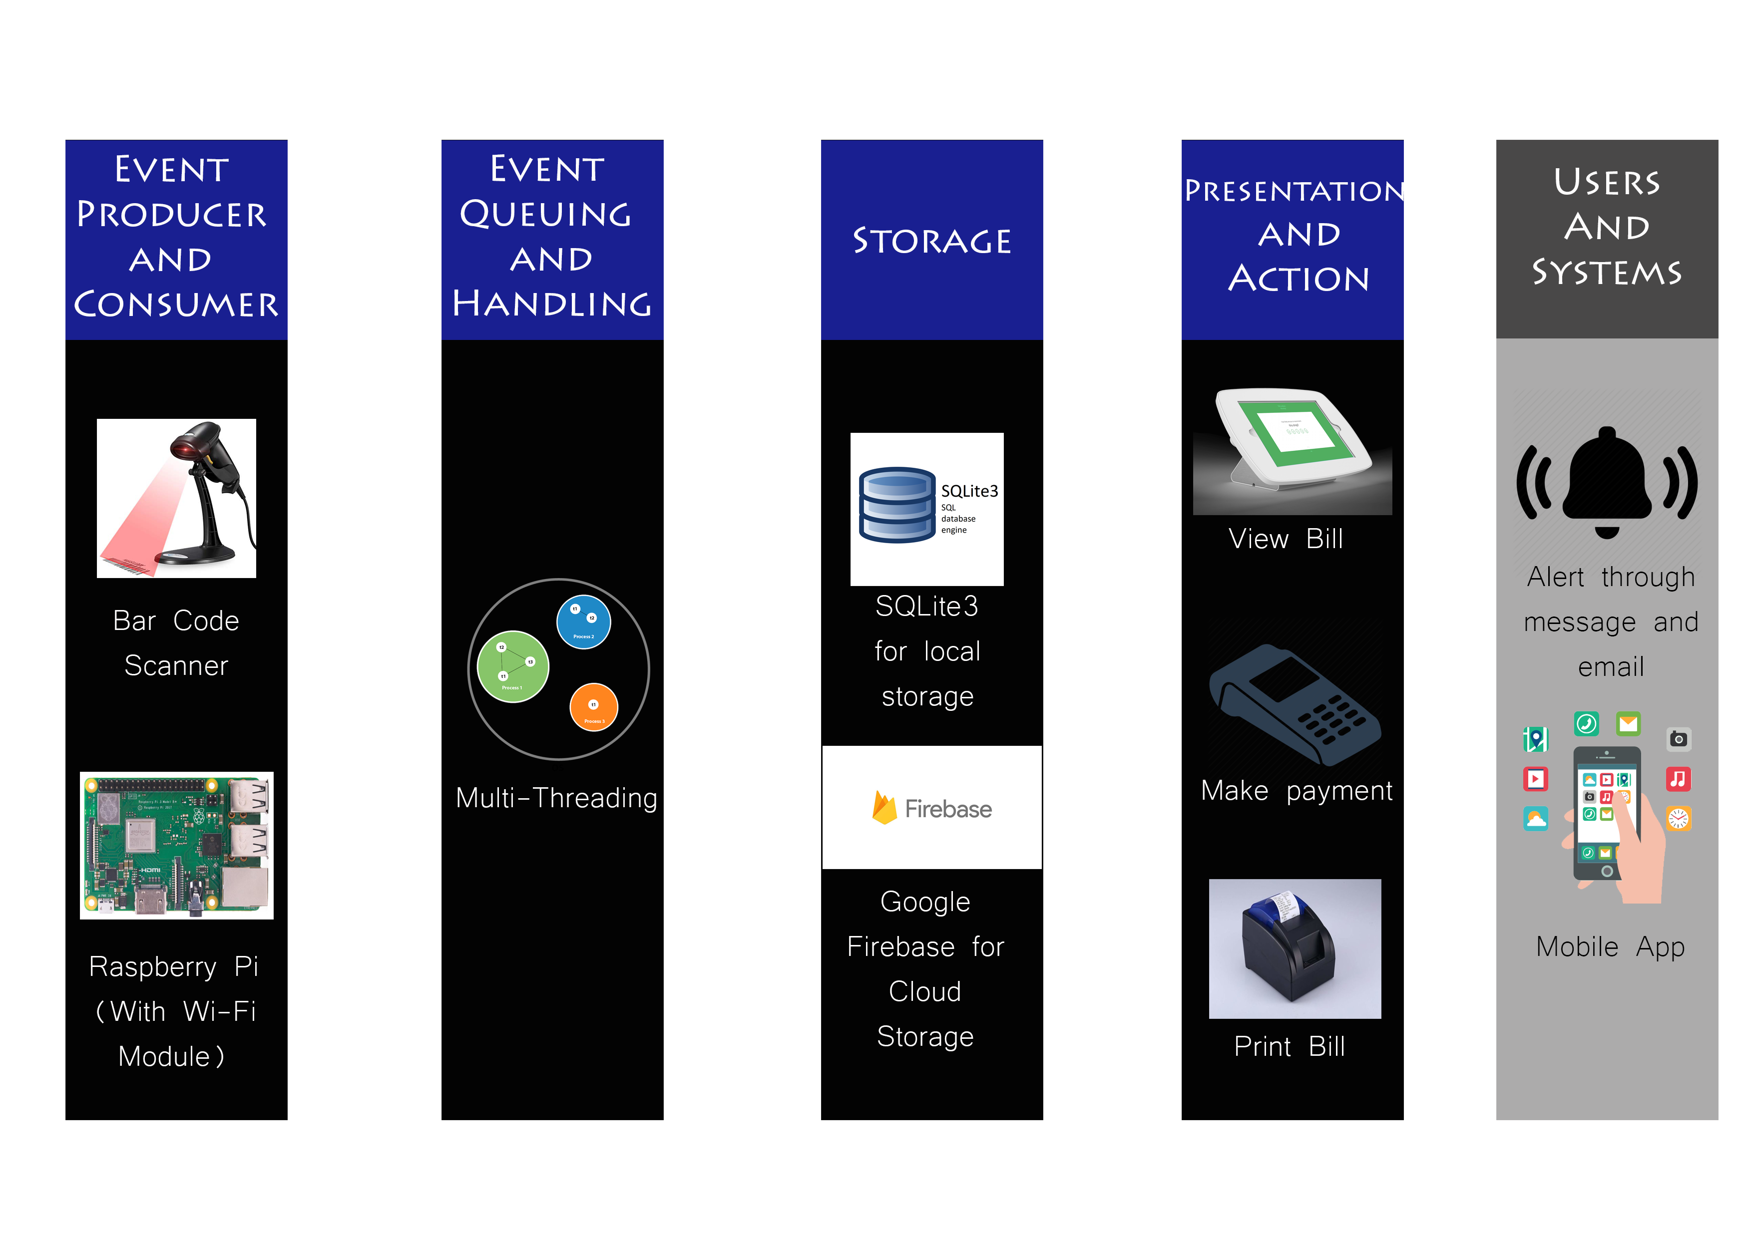

Slide 5

Logical Data Model

Slide 6

Test Data Set Availability
with Test Results

Slide 7


Installation and Execution Guide

